Slide 1
SVN
Lecturer: Ngo Huy Bien
Software Engineering Department
Faculty of Information Technology
VNUHCM - University of Science
Ho Chi Minh City, Vietnam
nhbien@fit.hcmus.edu.vn

Slide 2

Objectives
To use VisualSVN Server and TortoiseSVN for automating version control tasks.
To use Subversion for automating version control tasks.

Slide 3

Contents
VisualSVN Server
TortoiseSVN
Subversion

Slide 4

References

Slide 5
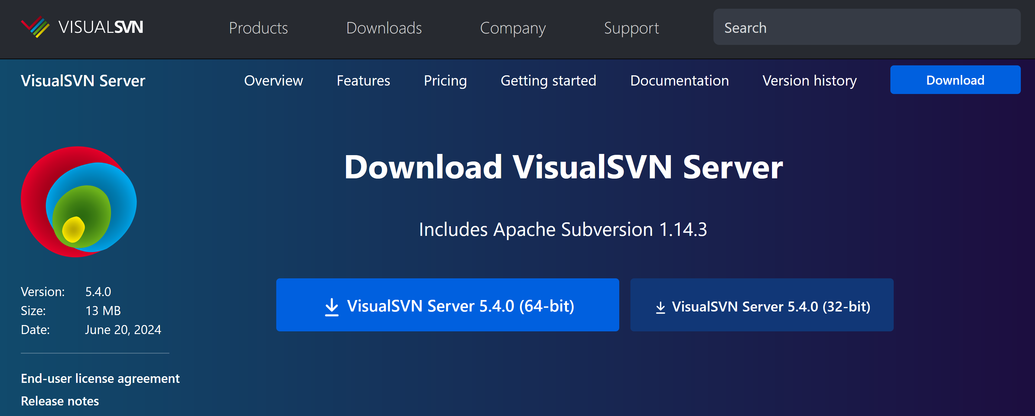
1. Download VisualSVN Server
https://www.visualsvn.com/server/download/

Slide 6
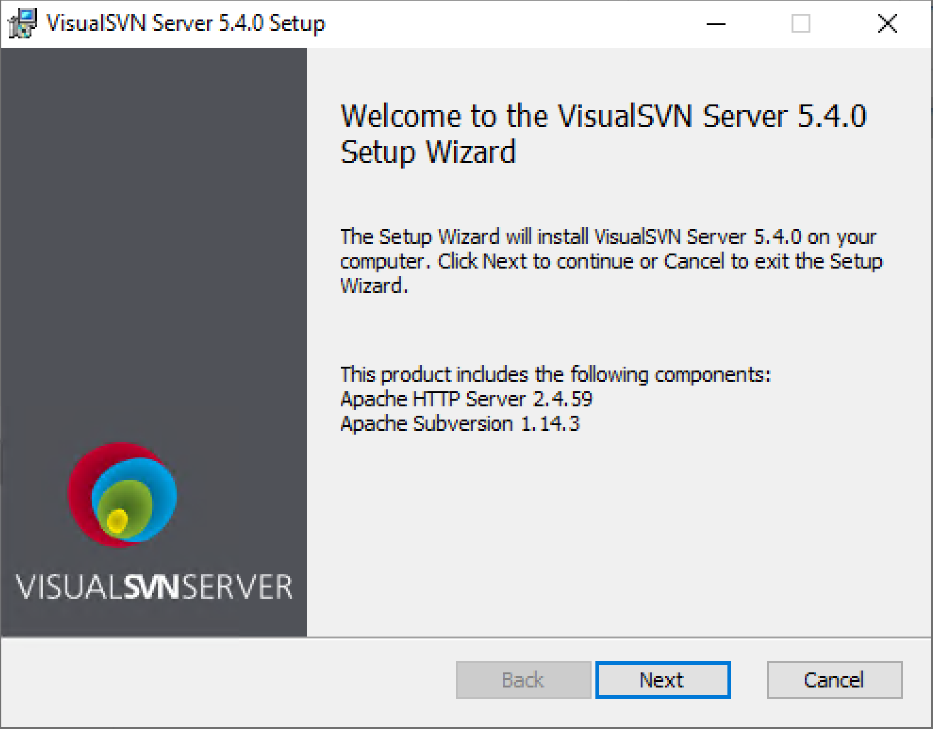
2. Install VisualSVN Server

Slide 7
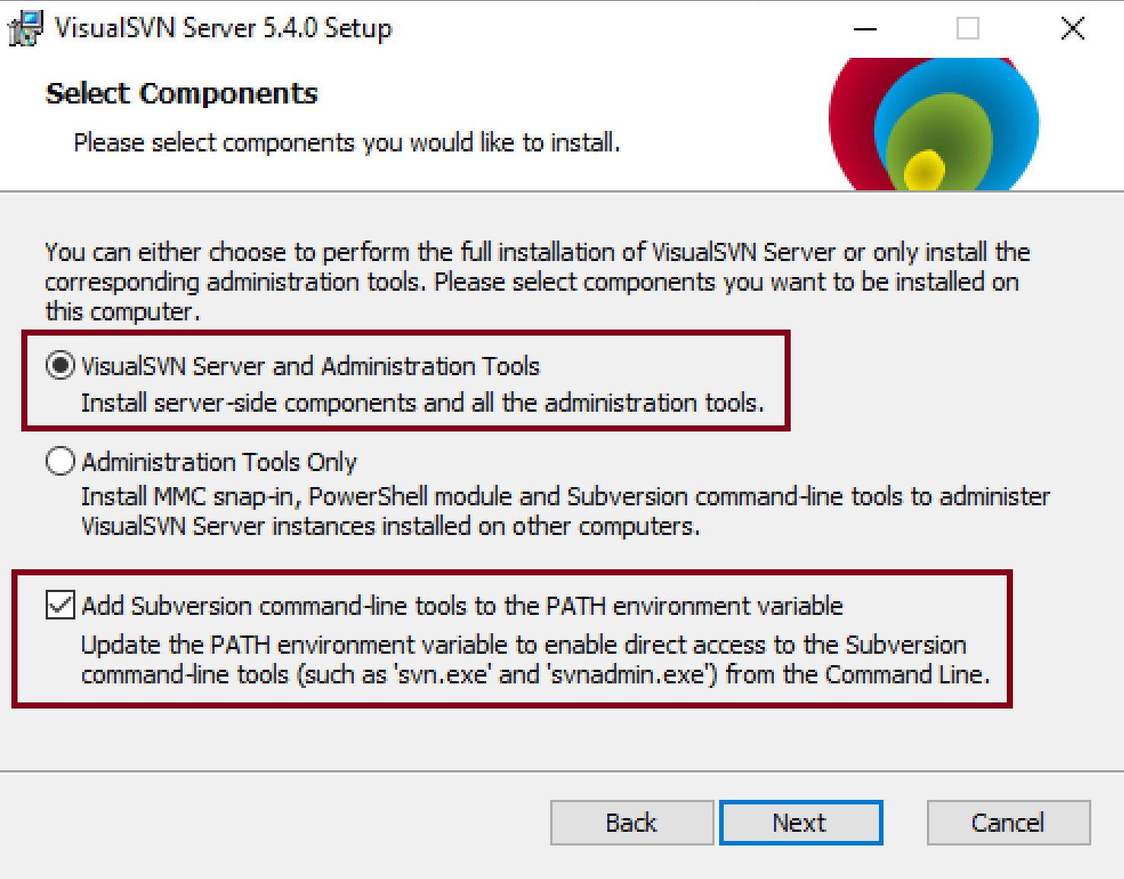
3. Select Components

Slide 8
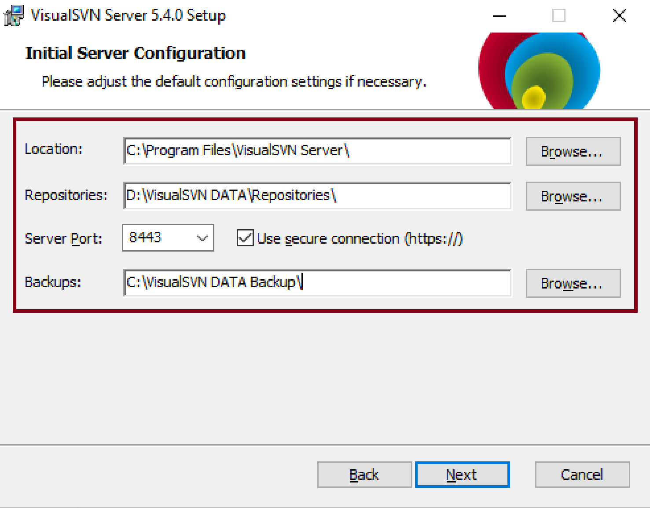
4. Select Server Configuration

Slide 9
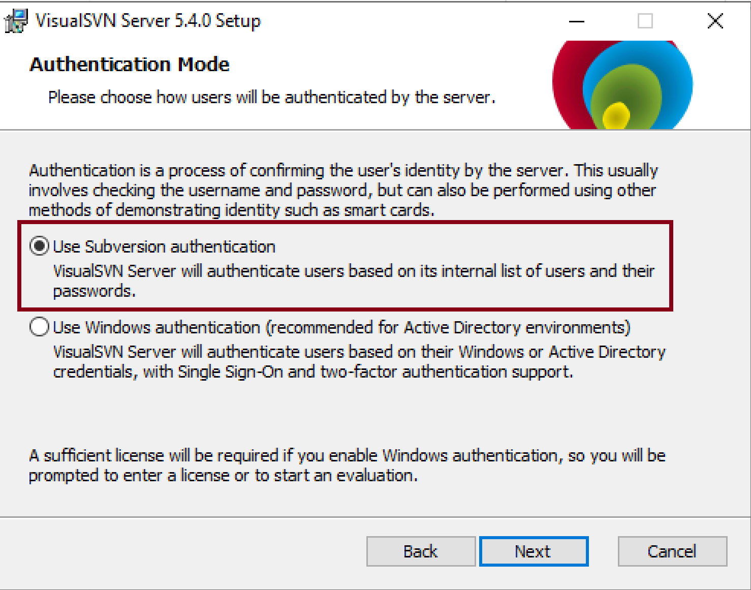
5. Select Authentication Mode

Slide 10
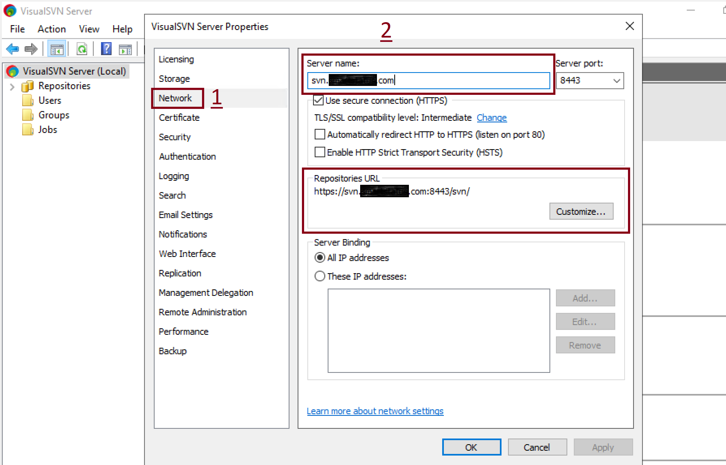
6. Set Server URL

Slide 11
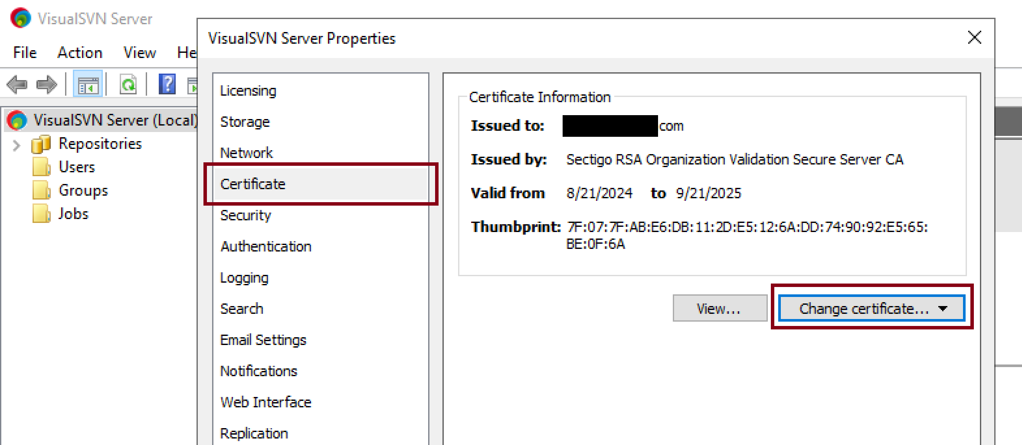
7. Import or Change Certificate

Slide 12


Slide 13
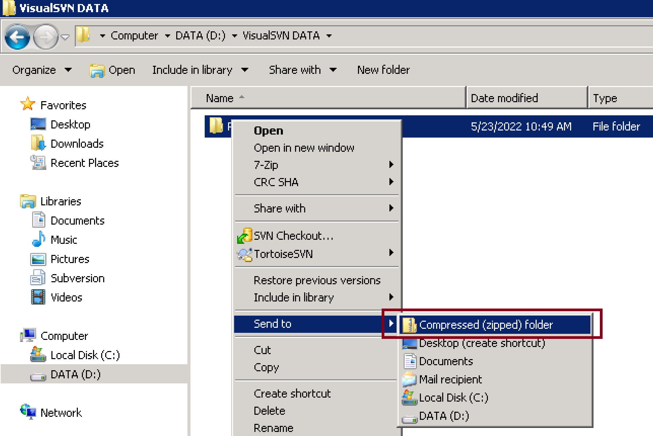
1. Compress all Repositories

Slide 14
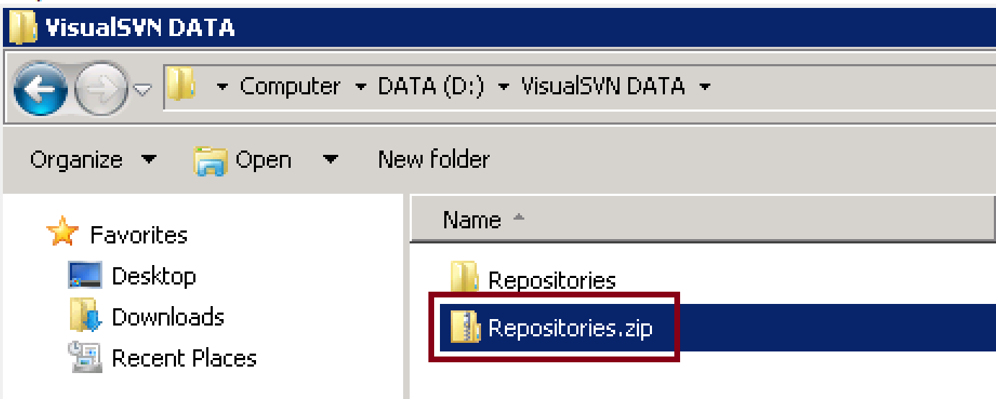
2. Copy ZIP File to New SVN Server
This ZIP file contains VisualSVN user credentials also.

Slide 15
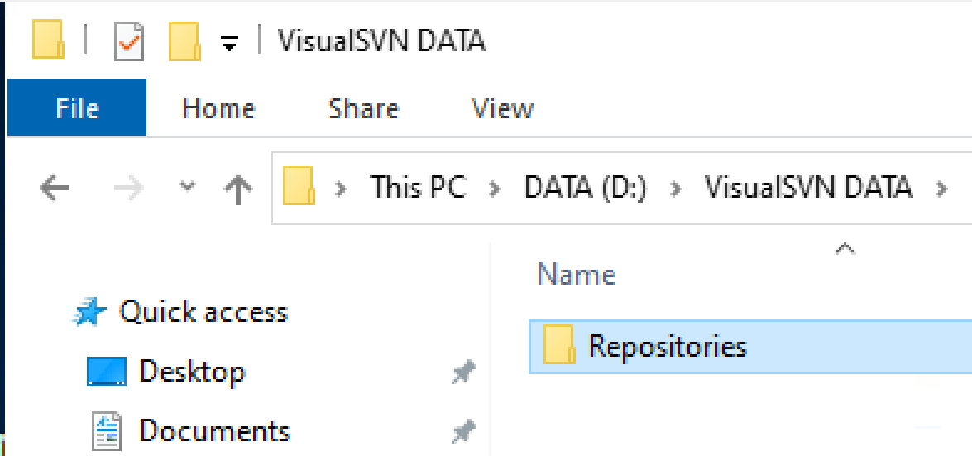
3. Overwrite Repositories Folder

Slide 16
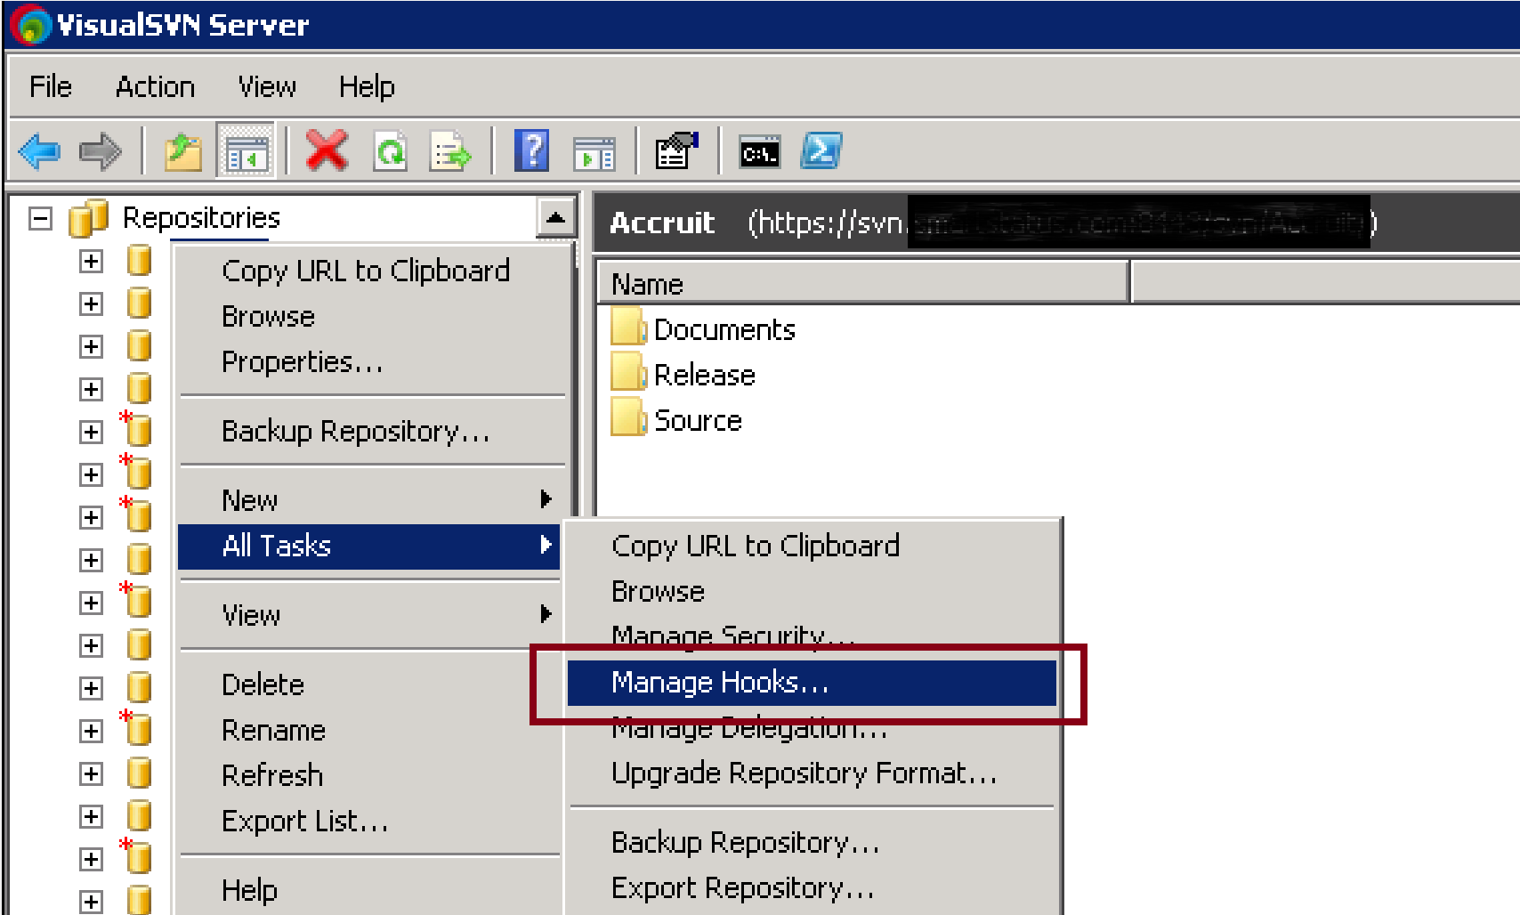
4. Manage Hooks

Slide 17
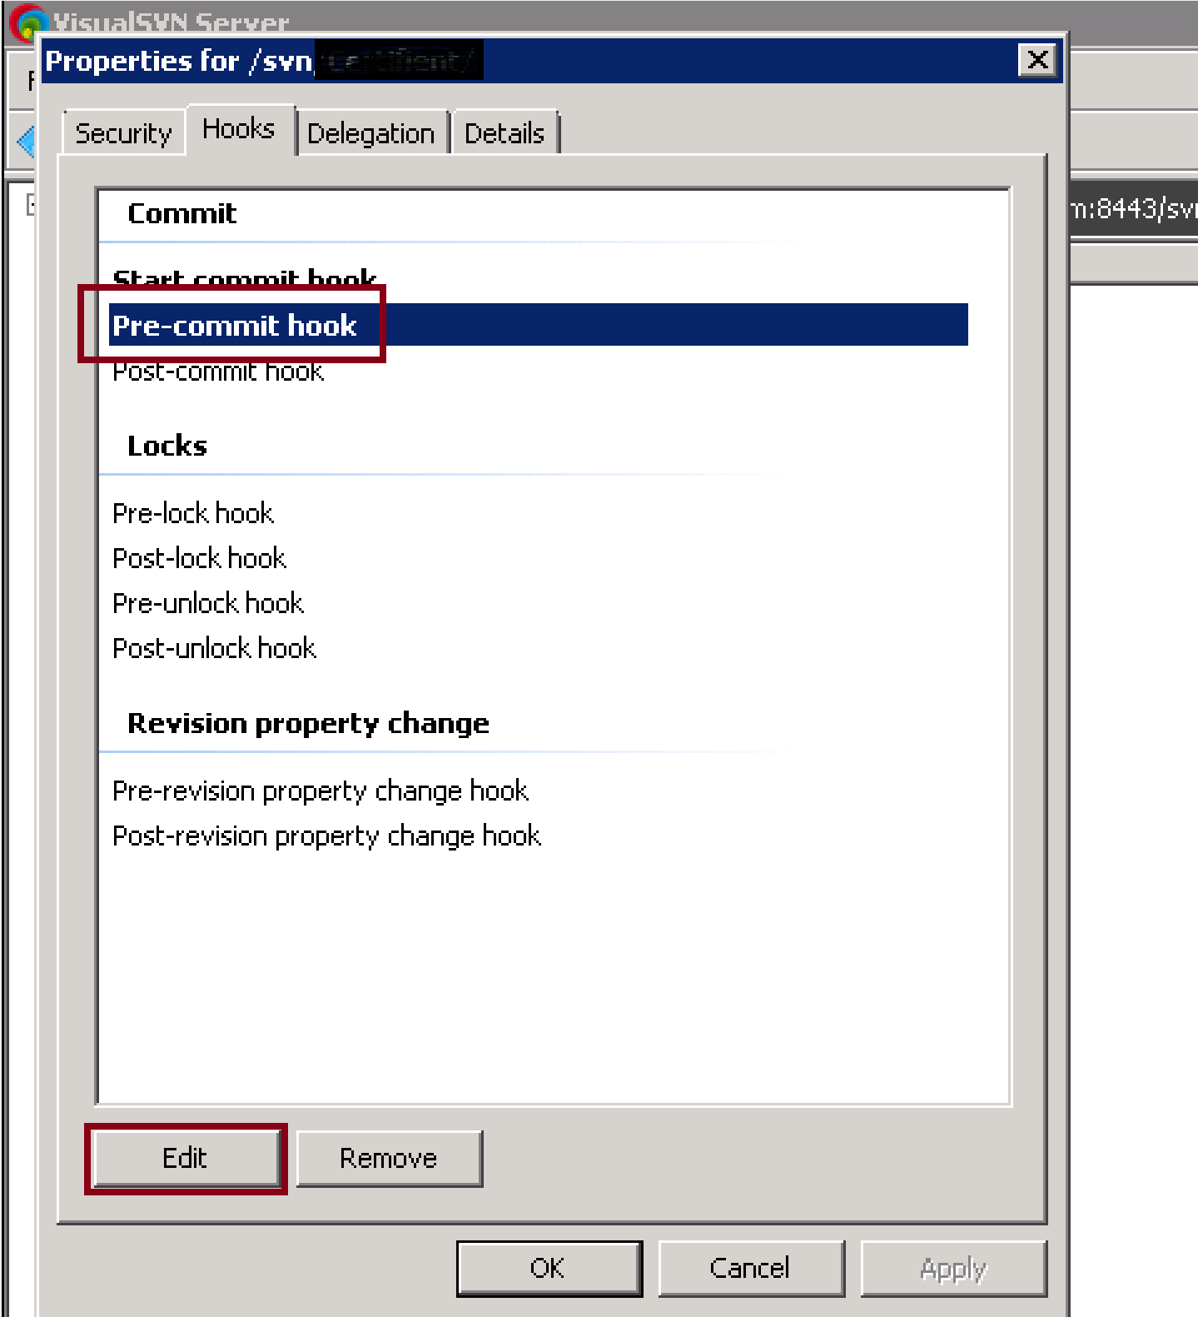
5. Edit a Hook

Slide 19
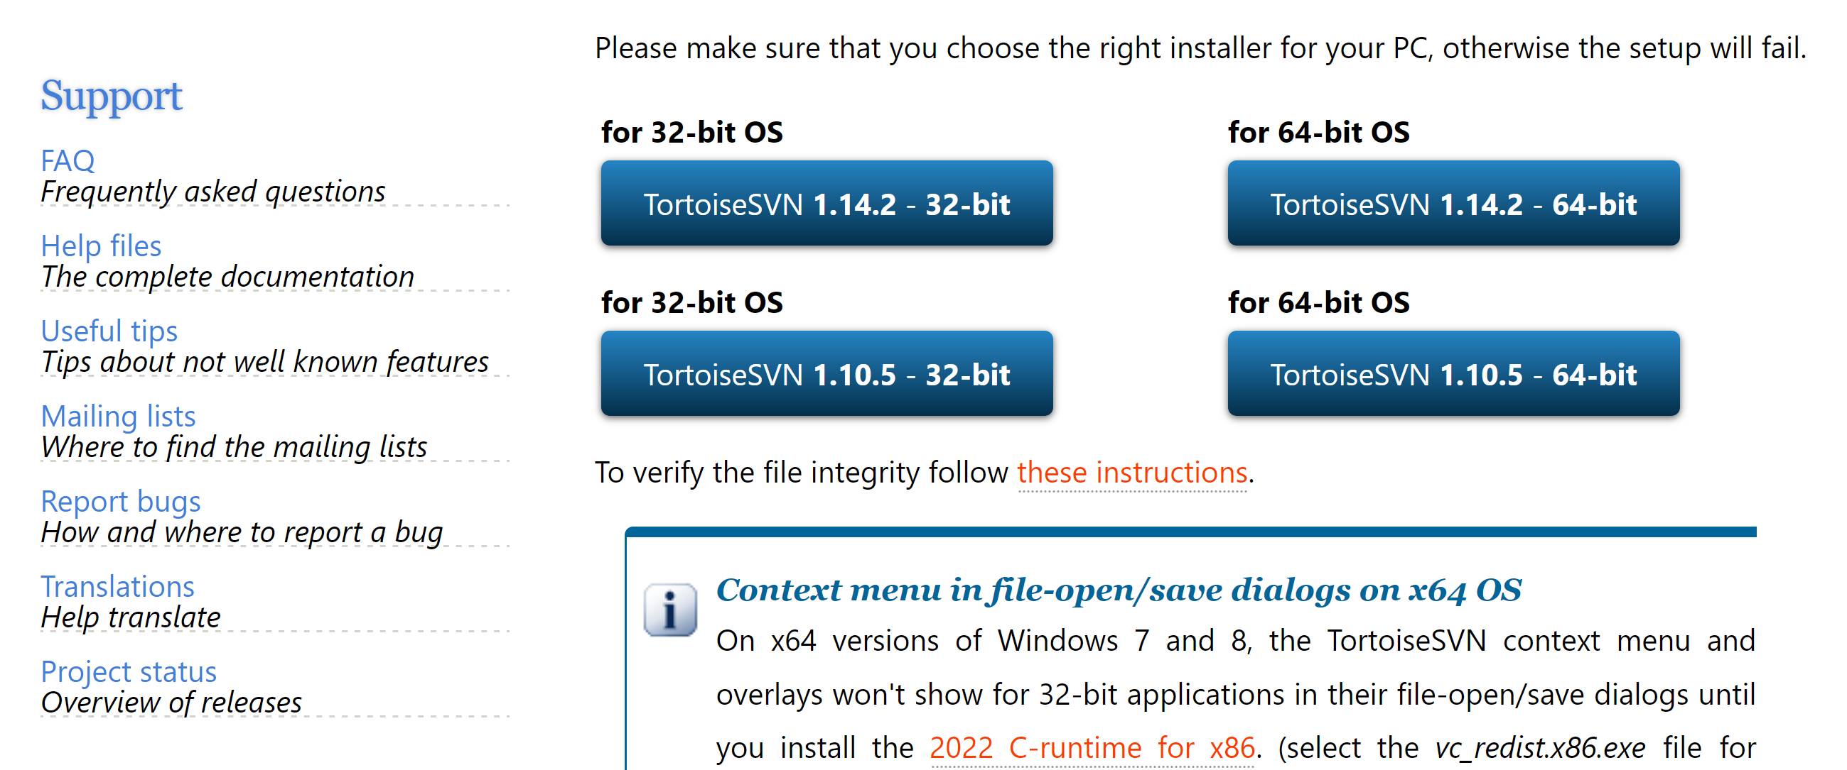
1. Install TortoiseSVN
https://tortoisesvn.net/downloads.html

Slide 20
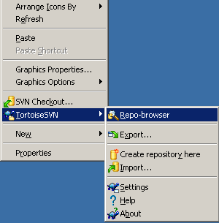
2. Open a Repository

Slide 21
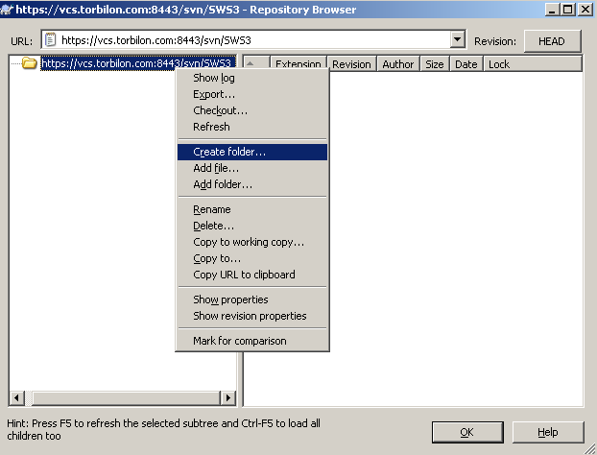
3. Create a Folder

Slide 22
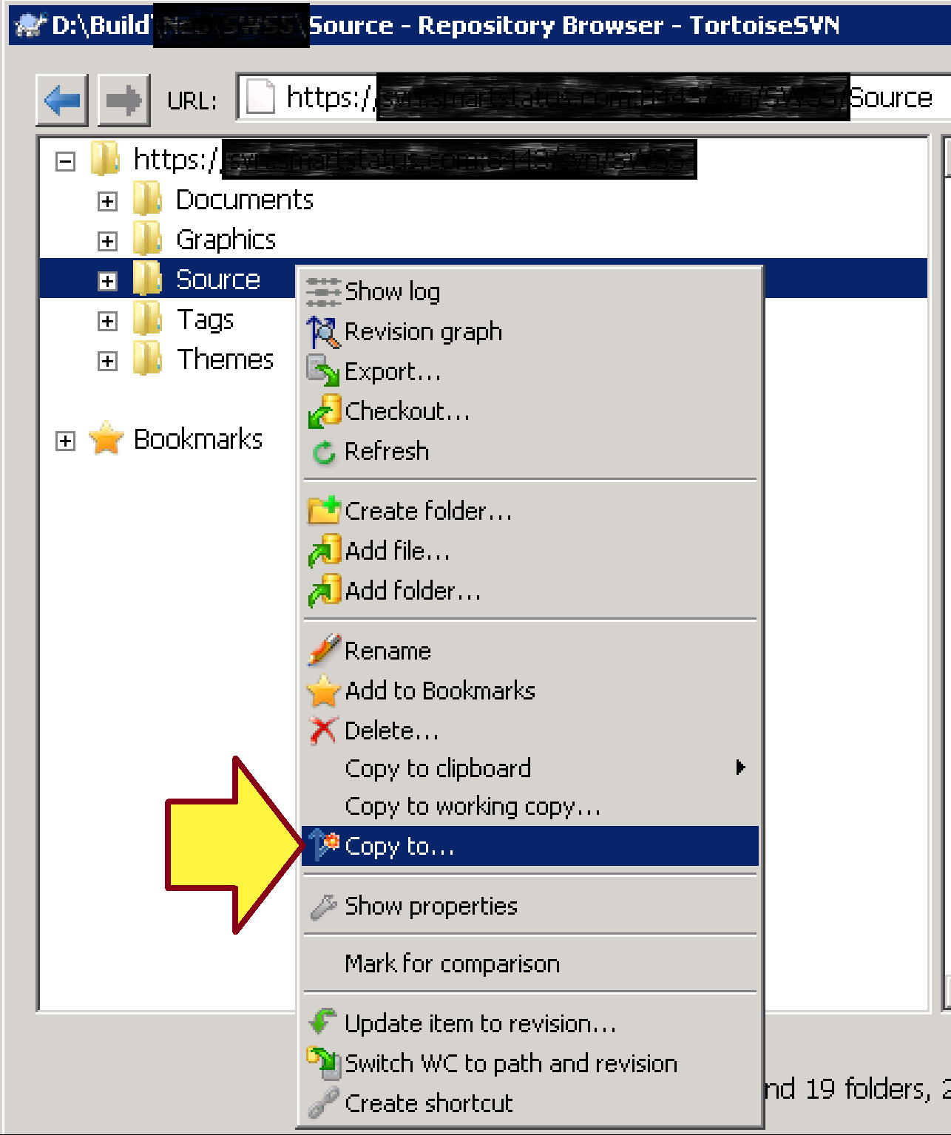
4. Create a Tag

Slide 23
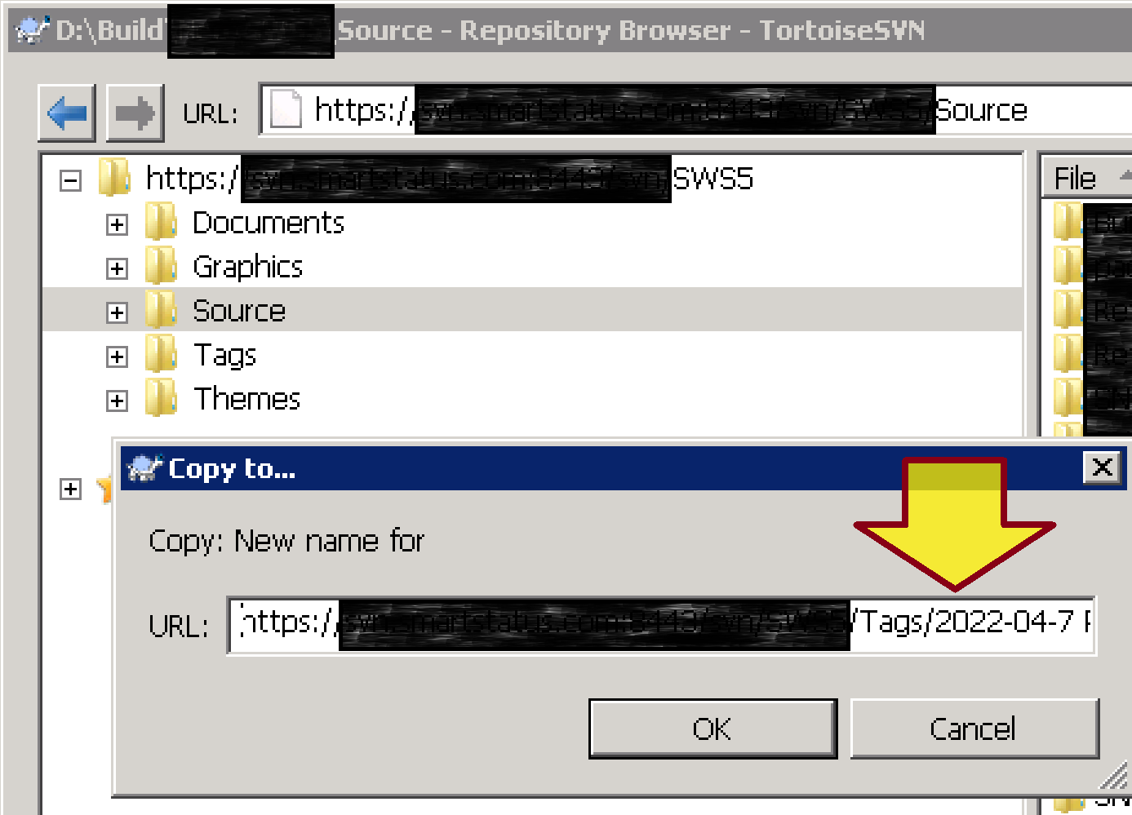
5. Enter a Name
Do NOT create the Tags/2022… folder first.

Slide 24
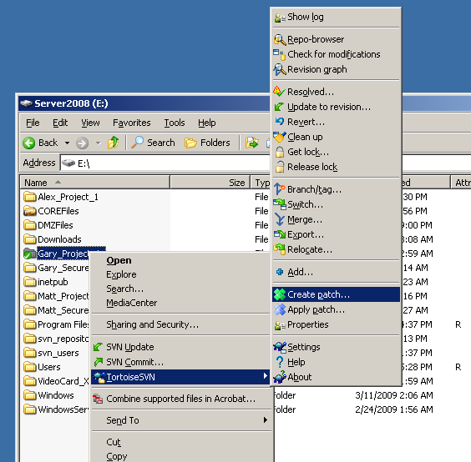
6. Create a Patch

Slide 25
"not a working copy directory" Issue
...XYZ "is not a working copy directory” error
"externally" remove XYZ from system
svn cleanup (to unlock parent directory)
svn revert XYZ (to remove "missing tag")

Slide 26
Check out a Single File
Try svn export instead of svn checkout. That works for single files.
The reason for the limitation is that checkout creates a working copy, that contains meta-information about repository, revision, attributes, etc.
That metadata is stored in subdirectories named '.svn'. And single files don't have subdirectories.

Slide 28
1. Install Subversion
https://subversion.apache.org/

Slide 29
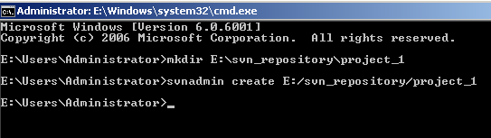
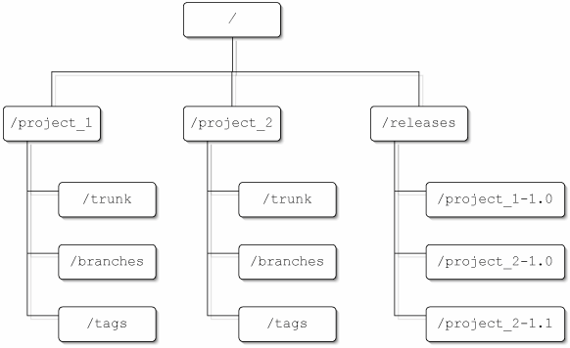
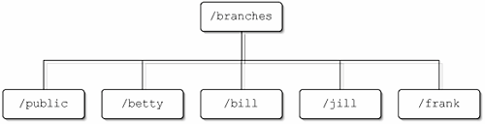
2. Create Repository (I)

Slide 30
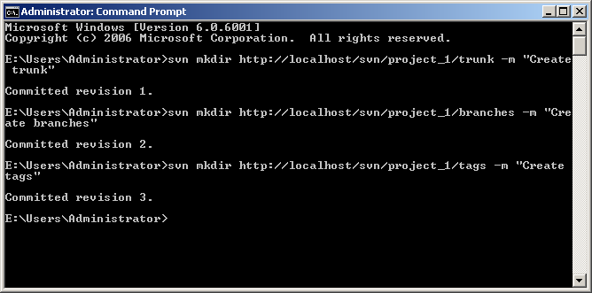
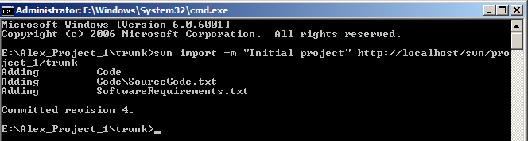
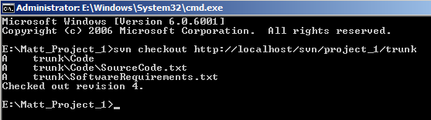
2. Create Repository (II)

Slide 31
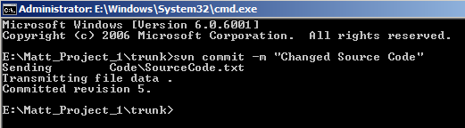
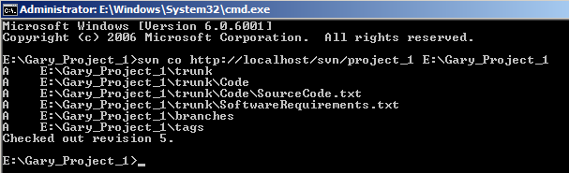
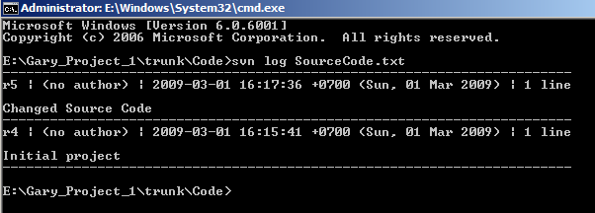
3. Commit Files

Slide 32
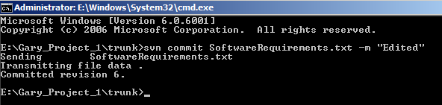
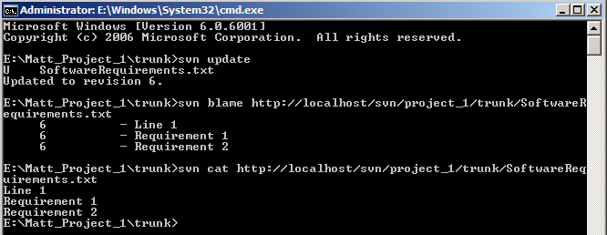
4. Update a Local Folder

Slide 33
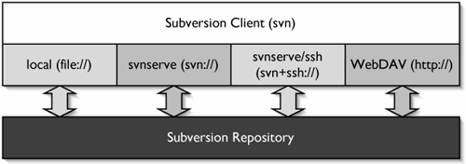
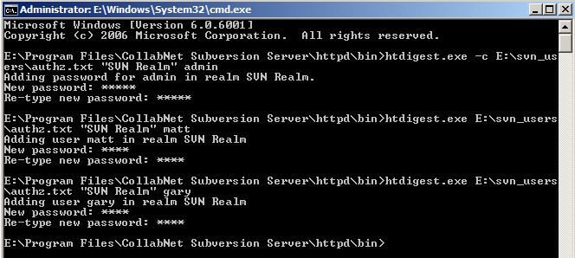
5. Control Access to the Repository

Slide 34
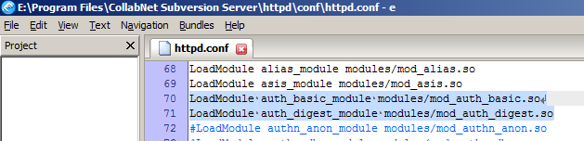
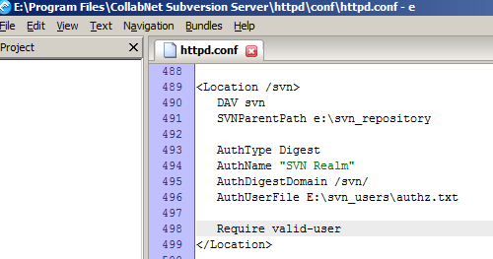
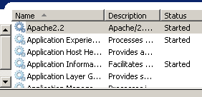
httpd.conf

Slide 35
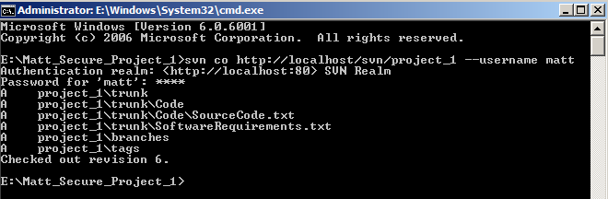
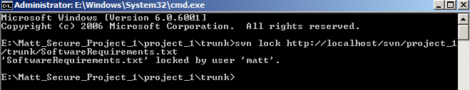
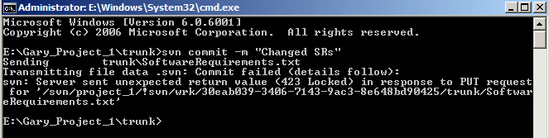
6. Lock a Remote File

Slide 36
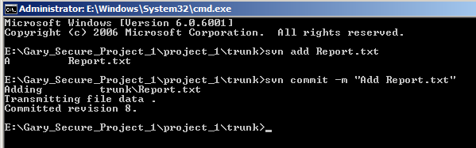
7. Add Files to the Repository

Slide 37
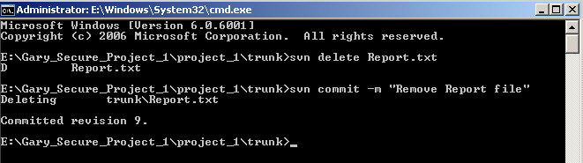
8. Delete Files from the Repository

Slide 38
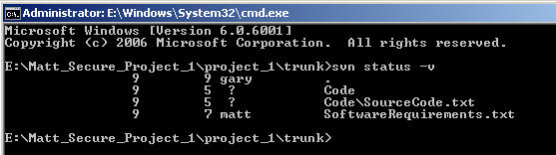
9. Show Files Status

Slide 39
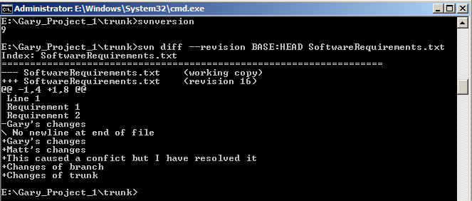
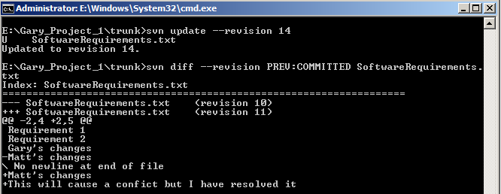
10. Compare Revisions

Slide 40
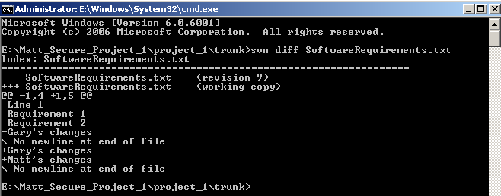
11. Show Revisions Difference

Slide 41
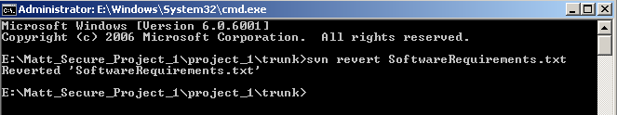
12. Revert a File to the Previous Revision

Slide 42
13. Clean Up a Folder
svn clean up
# Pristine copies: SVN keeps a local “pristine” copy of every versioned file in your working copy. These are the exact versions of the files as last updated/checked out. SVN uses them to calculate differences when you do svn diff or svn status.
# Vacuuming: This removes unused or corrupted pristine copies to free up disk space. It essentially cleans the .svn/pristine directory.

Slide 43
Vacuum pristine copies (I)
# Pristine copies: SVN keeps a local “pristine” copy of every versioned file in your working copy. These are the exact versions of the files as last updated/checked out. SVN uses them to calculate differences when you do svn diff or svn status.
# Vacuuming: This removes unused or corrupted pristine copies to free up disk space. It essentially cleans the .svn/pristine directory.

Slide 44
Vacuum pristine copies (II)
When you select "Vacuum pristine copies", SVN will:
Delete any pristine copies that are no longer needed (for example, if the file hasn’t changed since the last update).
Reduce disk usage in your working copy.
Potentially fix issues with corrupted pristine files that might prevent commits, updates, or diffs.
This does not remove your actual working files or modifications, only the internal pristine copies SVN uses.
After vacuuming, SVN can regenerate them if needed, but doing so may slightly slow down the next diff or status operation until the copies are rebuilt.

Slide 45
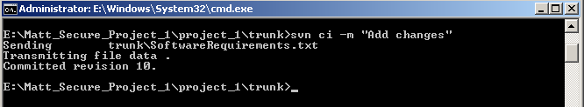
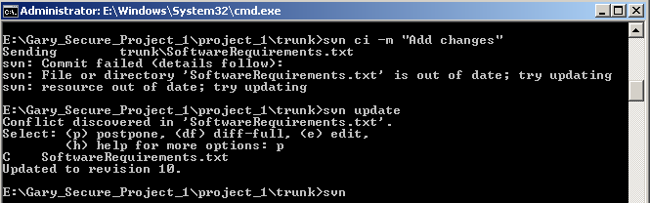
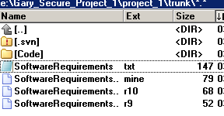
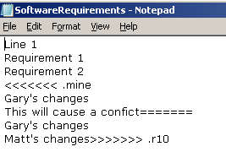
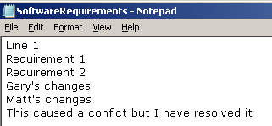
14. Resolve Conflicts (I)

Slide 46
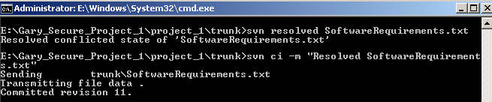


14. Resolve Conflicts (II)

Slide 47


15. Create Tag/Branch (I)

Slide 48

15. Create Tag/Branch (II)
svn copy "https://example.com:8443/svn/[ProjectName]/Source" "https://example.com:8443/svn/[ProjectName]/Tags/2019-05-13 Prior Patient Connect" -m "2019-05-13 Prior Patient Connect“
svn copy "https://example.com:8443/svn/NCM5/Source" "https://example.com:8443/svn/NCM5/Tags/2019-05-13 Prior Patient Connect" -m "2019-05-13 Prior Patient Connect"

Slide 49



16. Switch to a Branch

Slide 50



17. Merge a Branch into Trunk (I)

Slide 51

17. Merge a Branch into Trunk (II)

Slide 52

Thank You & See You Again

